Slide 1

Elements of managing a team, challenges
Team organization and structure, leadership

Slide 2
TABLE OF CONTENTS
Part
01
Part
02
Part
03
Part
04
Elements of
managing
a team
Challenges
Team
Organization &
Structure
Leadership

Slide 3
1
Elements of
managing
a team

Slide 4

Question
What do you think it takes to manage a team?

Slide 5
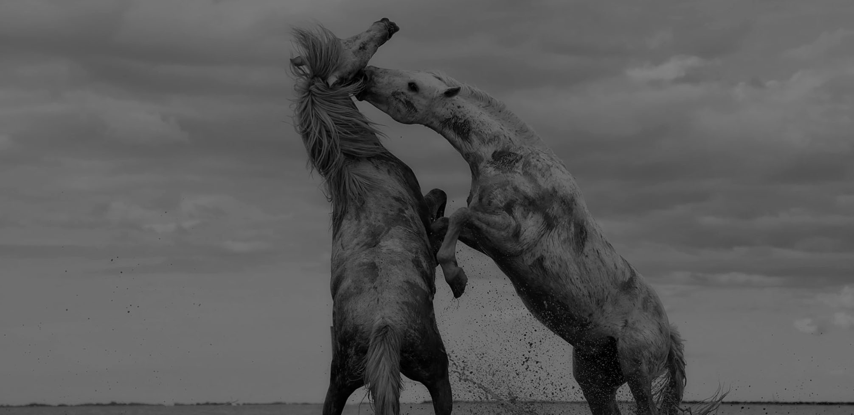
Seven elements of managing a team
1
Manage yourself
Make members understand their goals
5
2
Establish training and communication programs
Be a good team leader
6
3
Develop a rigorous work style
Coordinate team members
7
4
Humanized management

Slide 6
One
How to manage a team
You must manage yourself
To be a good manager, you must first do it yourself, become a role model for the team, bring your good work style to the team's work, influence the members of the entire team, impress every member with sincerity, and promote the team. A tacit understanding of cooperation.

Slide 7
Two
To build training and
Communication work in the team
Delivering excellent team culture and work skills to each teammate in cooperation, enriching team culture and work skills, is also the best way for team members to maximize their personal abilities in their work, so as to improve their combat effectiveness. The ultimate goal of a team's cooperation.

Slide 8
Three
Develop a rigorous work style at work
Teamwork requires everyone to work together, form a good working atmosphere, and influence each other's common growth. The purpose of setting up a team is to make the team grow up with personal strengths.

Slide 9
Four
Manage the team to be humanized
The team is cooperative, the studio is rigorous, but managers and members must be treated humanely, management should think about changing angles, and think about problems from the standpoint of members. How to better coordinate the relationship with members to establish a good relationship between the upper and lower layers. When discussing, we must treat the opinions and opinions objectively. The managers cannot say that they must be right. The managers must say that they are the best.

Slide 10
Five
Let each member clear the goal
Before the project begins, each team member must define his or her tasks, goals, and date of delivery. Then I know how to improve my work efficiency according to my work skills, so as to accomplish my work goals.

Slide 11
Six
Be a good commander behind the team
Team members always encounter problems that they cannot solve independently. At this time, the most important responsibility of being a manager is to help team members to solve problems, do a good job in command work, form a good communication mechanism, and train members to form at work. What problems have been encountered, the working habits reported in time, the manager can conduct a short discussion with the members, and give the best solution to the problem.

Slide 12
2
Challenges

Slide 13
Question
What do you think are the differences between work groups and team work?

Slide 14
Team characteristics
Working group
Teamwork
Leader
Manager
Executor
Team member

Slide 15
Team management
Team management refers to the organization of various groups in accordance with the nature and capabilities of members' work, participation in organizational decisions and problem-solving in an organization to improve organizational productivity and achieve organizational goals. Basically, the group is the basic unit of the organization. The formation of various groups, if the members' ability is complementary, forming a heterogeneous team, the effect is better, because it can be discussed from different viewpoints to stimulate more creative or more unique problem solving method.
Notes:
团队管理指的是在一个组织中，依照成员工作性质、能力组成各种小组，参与组织各项决定和解决问题等事务，以提高组织生产力和达成组织目标。基本上，小组是是组织的基本单位，各种小组的形成，若是成员能力具有互补性，形成异质性团队，其效果较佳，因为可以从不同观点讨论，激发更有创意或者更独特的问题解决方式。

Slide 16
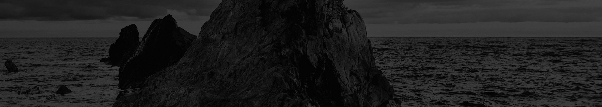
Challenges
The team lacks key skills、knowledge and solutions
The team's plan is incoherent
Arrogant emotions of team members
The division of labor is unclear and the responsibility of the staff is unknown: the team always pursues short-term goals or the objectives are not clear.
Members of the team often have confusion
Lack of collaborative work between team members
Notes:
1、团队缺少关键技能和知识及解决办法
2、团队的计划不连贯
3、团队成员的傲慢情绪
4、团队分工不清，人员责任不明，团队总是追求短期目标或者目标不明确
5、团队中经常有制造混乱的成员
6、团队成员之间缺少协同工作的习惯

Slide 17
Countermeasures
Improve team development capabilities
Grow in lessons learned
Avoid short-sighted behavior
Quick and sturdy
Resolve the emotions of resistance and resistance
Work focus and work ability
Notes:
1、提高团队的开发能力
保证团队完全明白所有的商务信息；强哈团队发现问题和解决问题的能力；提高团队的整体决策能力。
2、在经验教训中成长
如果团队已经做了错误决定，PM应该同团队成员一起坐下来，反省错误发生的原因并且强调从这次教训中可以学到什么。日后采取哪些措施可以确保这类过失不再发生，而不是指责任何人。
3、避免短视行为
确保所有团队成员对该组织、其目标和结构有一个基本认识。团队成员几首全局观点越强，他们在做决策时对整个工作的考虑就会越多，就更能克服近视倾向
4、快刀斩乱麻
作为一个PM，在决策和实施决策计划时都必须当机立断；任何延误都会造成严重的后果。
5、解决反抗与低至情绪
技术人员一般都会有一定的反抗和抵制情绪，PM都应该明白一点，克服团队反抗情绪的最佳策略是把时间和经历都集中在谈论如何实现项目目标上。在这个大前提下，充分激发团队成员的积极性。
6、工作重点和工作能力
PM可能不是技术专家，所以作为主管工作的重点应该是调动团队成员的积极性，为解决技术问题创造充分的条件。一个团队也应该及时的获取和使用心得知识。

Slide 18
3
Team organization and structure

Slide 19
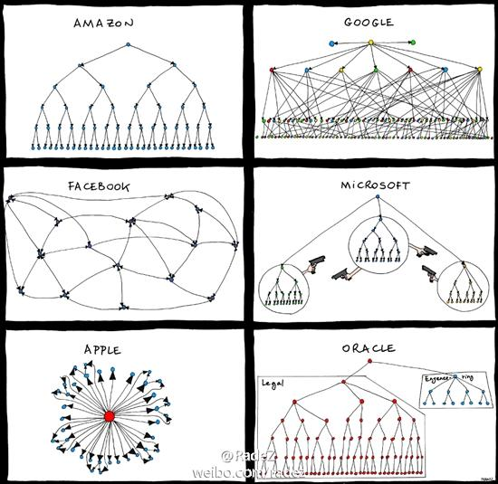
Organizational structure of well-known companies
Notes:
如上图所示，这些图非常形象的描述了几家顶尖科技公司的组织架构。其实组织架构并没有好与坏之分，几家公司也都非常成功。但是不同的组织架构的确为这些公司未来的发展产生了深远的影响。
回到我们自己，我们应该怎么设计自己的组织架构呢？在设计的过程中，又应该考虑哪些因素呢？
观察这几家公司的组织架构，我觉得有一个主干的脉络可以帮助我们理清思路，虽然组织架构千差万别，但其实都在围绕一个脉络来进行设计。这个脉络就是组织的决策流。

Slide 20
Decision flow
Collect message
Decision maker
Executor
Result
Notes:
什么是决策流呢？就是组织从收集信息到落地实现的整个流程。如下图所示，他包括四个过程点，分别是信息收集者、决策者、执行者和结果反馈，信息收集者采集客户信息，决策者根据这些信息进行决策，执行者按照决策进行组织生产，最后产生结果又得到客户反馈。这四个节点组成了决策的闭环，体现了组织对外界变化的响应能力。设计组织架构就是一个让决策闭环流逐渐高效的过程。

Slide 21
Collect Message
The first is the information gathering node, and all decisions must be made with certain information. Therefore, information collection is very important. For enterprise organizations, the core message is the first-line feedback from customers or users. Simply put, what is your product, how is your word of mouth? Only by knowing these first-line information can we change our strategy, optimize our products, and make the right decisions.
The goal of the organizational structure is to make this process more efficient. For information gathering nodes, it is required to collect information in a timely and comprehensive manner, and to pass on information to decision makers as quickly as possible and without loss of information. How can I do this? That requires the information transfer chain between the information collector and the decision maker to be short enough. How can it be short enough? Getting information collectors to participate directly or to lead decisions is perhaps an option.
Notes:
首先是信息收集节点，所有的决策都得在掌握一定信息的情况下才能做出。所以，信息收集非常重要。对企业组织来说，最核心的信息就是客户或者用户的一线反馈。简单说就是你的产品到底怎么样，口碑如何。只有知道了这些一线的信息，我们才能及时的改变策略，优化产品，做出正确的决策。
组织架构的目标就是要让这个流程更加高效。对信息收集节点来说，就要求及时全面的收集信息，并且尽可能快和不丢失信息的传递给决策者。怎么才能做到这一点呢？那就要求信息收集者和决策者之间的信息传递链条足够短才行。怎么才能足够短呢？让信息收集者直接参与或者主导决策，或许是一种选择。
……
所以说，一定程度上，你做的业务以及你的业务定位，就会决定了不同的决策传导流程，这个不同的流程就会决定你的组织架构。当然，在业务的不同阶段也会有不同的目标，根据目标还需要变换对应的组织驱动方式。

Slide 22
Decision maker
Let's take a look at the decision makers. On the one hand, the lower the level of decision-making, the better. Just now we mentioned that information collectors can enter the decision-making circle, thus reducing the path of information transmission.
On the other hand, it is also possible to organize a certain authorization for the lower layer and also reduce the conduction level. In other words, let the underlying organization also have certain decision-making power, rather than reporting everything. This is actually a flat organizational structure that many people are discussing.
Notes:
再来看看决策者环节，一方面，决策的层级越少越好，刚才我们提到，可以让信息收集者进入决策圈，这样就减少了信息传导的路径。
另一方面，还可以给下层组织一定的授权也可以减少传导层级。也就是说让底层的组织也有一定的决策权，而不是事事汇报。这其实就是很多人在讨论的扁平化组织架构。

Slide 23
Executor
The executor still has a hierarchical relationship, and still have to consider the issue of flattening just mentioned
In addition, the executive team needs to have certain professional skills to complete the specific project implementation. In addition, because of the collaboration involving large-scale projects, members also need the ability to organize and coordinate.
Notes:
执行者依然会有层级的关系，依然要考虑刚才说到扁平化的问题。
除此之外，执行者团队要完成具体的项目实现，就需要团队成员具备一定的专业技能。另外，因为涉及大规模项目的协作，还需要成员有一定组织协调的能力。

Slide 24
Result feedback
Finally, take a look at the results feedback link of the decision process. Any organizational structure is designed to serve the business objectives, that is, to serve the end result. The resulting results will generate feedback among the customers, and the information collector will get the information, which will influence the decision-making, and the final decision-making process will be closed.
As you can see, from the information collection to the final result, the information transmission process will gradually lose information, how to make the process more efficient, this is a process of continuous optimization and adjustment. Go along the chain of decision-making, because everyone has different divisions of labor, and everyone's goals will be inconsistent. How to make each role work together, we will continue to explore this issue in the future.
Notes:
最后，再看一下决策流程的结果反馈环节。任何组织架构的设计都是为了业务目标服务的，也就是为了最终结果服务的。产生的结果会在客户中产生反馈，信息收集者就会得到这些信息，从而影响决策，最终的决策流程闭环就完成了。
大家可以看到，从信息收集到最终结果，信息传导过程中会逐渐丢失信息，如何让流程更加高效，这就是一个不断优化和调整的过程。沿着决策链条走，因为大家有各自不同的分工，大家的目标也会不一致。如何让各个角色能协同起来，我们后续还会继续探讨这个问题。

Slide 25
4
Leadership

Slide 26
Question
Why is the leadership gap widening?
&
What are successful leaders doing?

Slide 27
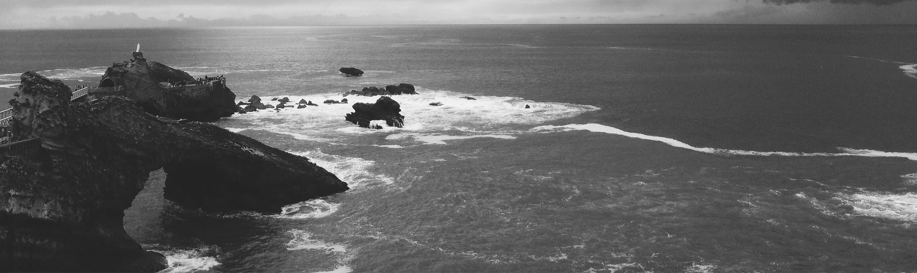
Leadership in the 21st century is defined
and evidenced by three questions

Slide 28
Three questions
Where are you looking to anticipate change?
What is the diversity measure of your network?
Are you courageous enough to abandon the past?
Notes:
Where are you looking to anticipate the next change to your business model or your life?
What is the diversity measure of your personal and professional stakeholder network?
Are you courageous enough to abandon a practice that has made you successful in the past?
Go along and get along 随遇而安，取法中庸

Slide 29

THANKS FOR LISTENING!
Any Questions?

